Slide 1
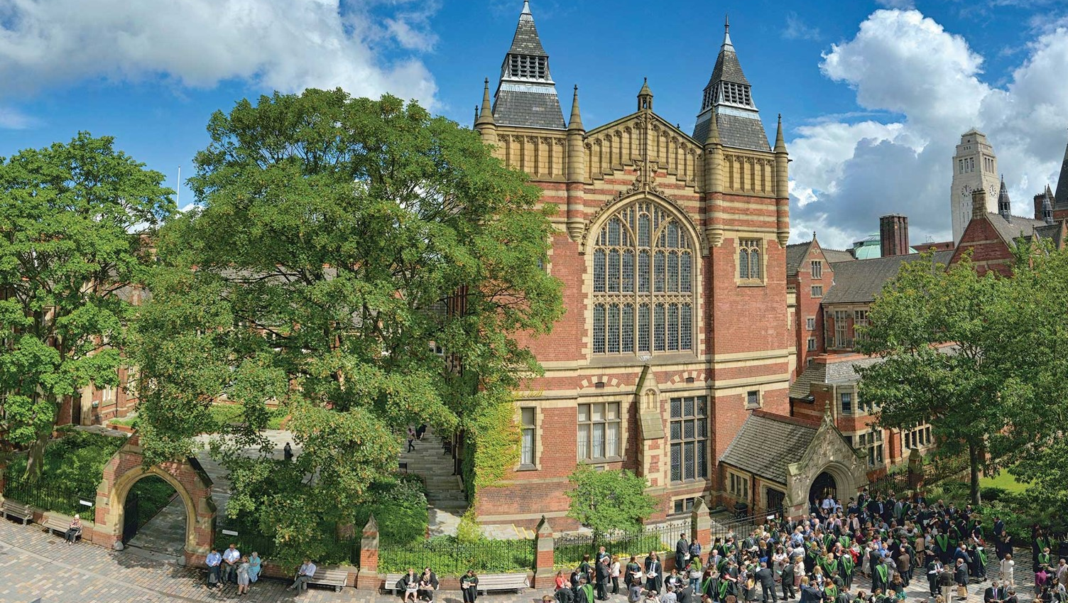
University of Leeds Strategy 2020-2030
Universal Values, Global Change

Slide 2
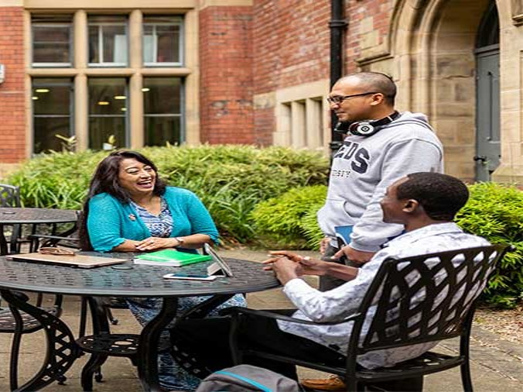
Overarching elements
Community
Culture
Impact
Reducing inequalities
Value-driven University

Slide 3
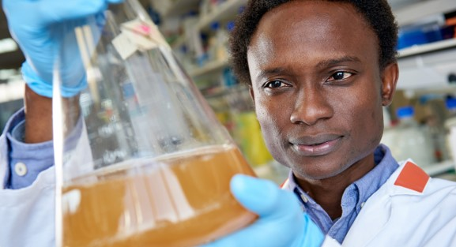

The core strategy
Research and Innovation
Student Education
Digital Transformation
International

Slide 4
Research and Innovation
Our vision
Our culture and environment will place us at the centre of a global research and innovation community, delivering transformational fundamental and challenge-led research to advance knowledge and tackle local, national and global challenges.

Slide 5
Research and Innovation aims and objectives
Support our research staff across their entire career to help them achieve their full potential, and deliver fundamental and challenge-led research that will shape our future world.
Further our reputation for high quality challenge-led, interdisciplinary research underpinned by our disciplinary fundamental research strengths.
Remove institutional barriers and promote Leeds as a ‘university without walls' to support interdisciplinarity and effective external partnerships.
Enhance and diversify our research income and the impact and innovation it generates.

Slide 6

Student Education
Our vision
To provide a transformative, research-based educational experience for students from diverse backgrounds, who develop the knowledge and skills they need to succeed and make a positive impact in the world.

Slide 7
Student Education aims and objectives
Engage students as partners in their education, through active and inclusive approaches to learning, and research-based content.
Provide an outstanding education, underpinned and enhanced by sector-leading digital resources, pedagogies and technologies.
Foster an engaged and lifelong community of staff, students, alumni and partners.
Embed a sustainable approach to delivering high-quality, research-based education.

Slide 8

Digital Transformation
Our vision
We will use digital technologies, data and digital approaches effectively, creatively, innovatively and in a research-informed way to enhance our students’ learning and experience, to provide and enrich learning opportunities for individuals globally, to enhance our research activity and impact to tackle global challenges, and to improve the University’s processes, infrastructure and physical estate.

Slide 9
Digital Transformation aims and objectives
Enhance ways of working, campus facilities and operational activity.
Improve our capabilities to conduct high quality, collaborative and globally impactful challenge-based research and innovation.
Enhance our educational provision and grow our fully online education portfolio.

Slide 10

International
Our vision
To be a truly international university with global reach and impact through internationally relevant, accessible, high-quality education and world-changing research and innovation.

Slide 11
International aims and objectives
Foster and embed an international mindset across all aspects of our activity.
Continue to build, engage and support our globally connected community of staff, students and alumni.
Create global partnerships that provide international learning and research opportunities to develop engaged global citizens and world-changing research and innovation.
Enhance our international reputation by extending our worldwide reach and delivering global impact.

