Slide 1
USS Pension Update
September/October 2019

Slide 2
Purpose of today
To update you on recent discussions and decisions about the USS pension scheme, including the outcome of the most recent valuation and what it means for you and for the University.
To take your questions and answer them where we can.
By law, we are not able to provide personal financial advice. If you need more information, speak to the University pension team or USS about your own scheme membership. If you need personal financial advice, speak to an independent financial adviser.

Slide 3
Headlines
Member benefits remain unchanged.
Employers support the recent conclusion to 2018 valuation, which means an increase in contribution rates.
Employers will pay bigger share of contribution increases in 65:35 split with members.
The Joint Expert Panel (JEP) is expected to report later in the year with recommendations regarding scheme governance and future valuations.

Slide 4
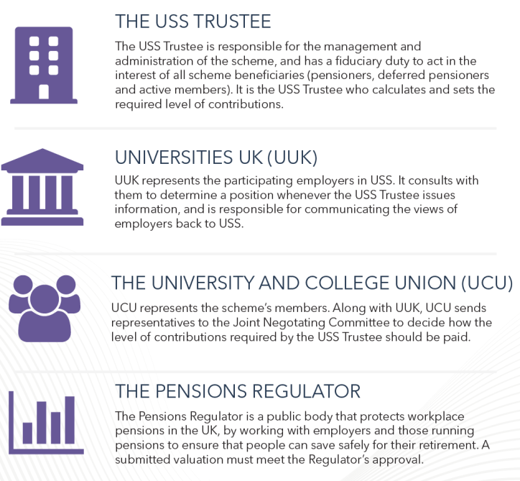
Who does what?

Slide 5
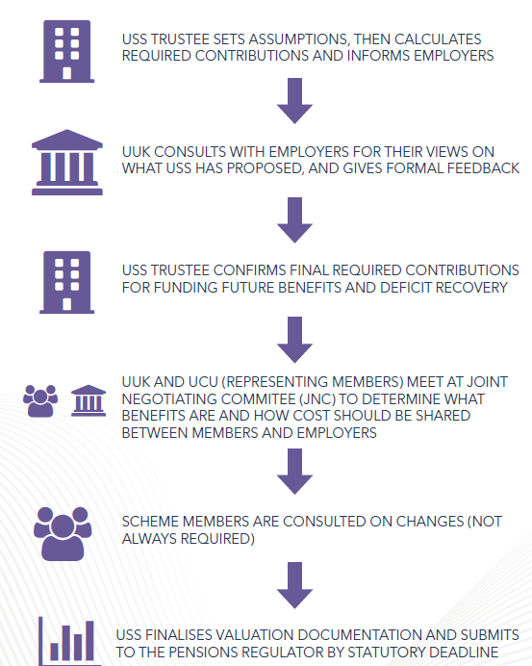
How decisions are made

Slide 6
Joint Expert Panel (JEP)
… the JEP comprises independent pensions experts, created by UUK & UCU following the failure to reach agreement over how to fund USS at the 2017 valuation.
The JEP’s first report focused on:
a re-evaluation of employer risk
consistency with the 2014 valuation
fairness and equality between generations
updated market conditions
The JEP’s second report is being prepared.

Slide 7
How USS works
A ‘defined benefit’ component [the USS retirement income builder] providing stability by paying a defined pension on retirement, calculated in relation to salary.
A ‘defined contribution’ component [the USS investment builder] providing flexibility, with employers and employees contributing to an investment pot used to generate income for retirement.
The DB component applies up to a salary threshold (£58,589 in 2019/20) which increases annually in line with CPI.

Slide 8
Valuations
Are there enough assets to pay for all the benefits built up until the time of a valuation
How might liabilities (mainly the cost of future benefits) be in the future?
 | £billion
 | Assets | Liabilities | Deficit
2014 valuation | 41.6 | 46.9 | 5.3
2017 valuation | 60.0 | 67.5 | 7.5
2018 valuation | 63.7 | 67.3 | 3.6
The next valuation will take place in 2020

Slide 9
2018 Valuation: Contribution options
The USS position with no formal contingent support: Rejected
% | to 30/3/19 | 1/4/19 – 30/9/19 | 1/10/19 – 30/3/20 | 1/4/20 – 30/9/21
Employer | 18.0 | 19.5 | 22.5 | 23.0
Members | 8.0 | 8.8 | 10.4 | 10.7
Total | 26.0 | 28.3 | 32.9 | 33.7
Conditions placed on employers: Preferred option
%
Employer | 18.0 | 19.5 | 21.1 | 21.1
Members | 8.0 | 8.8 | 9.6* | 9.6*
Total | 26.0 | 28.3 | 30.7 | 30.7
*UUK proposed adjustment to 9.1 was rejected

Slide 10
Valuations: recent history
2017 valuation
% | to 30/3/19 | 1/4/19 – 30/9/19 | 1/10/19 – 30/3/20 | 1/4/20 – 30/9/21
Employer | 18.0 | 19.5 | 22.5 | 24.2
Members | 8.0 | 8.8 | 10.4 | 11.4
Total | 26.0 | 28.3 | 32.9 | 35.6
JEP: September 2018
%
Employer | 18.0 | 20.1 | 20.1 | 20.1
Members | 8.0 | 9.1 | 9.1 | 9.1
Total | 26.0 | 29.2 | 29.2 | 29.2

Slide 11
Current position
JNC met on 20 and 22 August 2019 and agreed
No benefit changes
Total contribution rate of 30.7%, with the increase shared 65:35 employers/members
Contribution rates effective October 2019 until end September 2021
21.1% employers
9.6% members
Revised contribution rates supersede previous levels proposed by USS following the 2018 valuation of 10.4% rising to 10.7%
UUK offer to pay additional 0.5% for 2 years (reducing members contributions to 9.1%, exactly in line with JEP proposal) rejected by UCU
The 21.1% : 9.6% contribution rates were ratified at USS Trustee Board on 12 September

Slide 12
Members’ monthly contribution rates
 | Superseded 2018 valuation rates |  | JNC decision | Rejected offer
Salary of average scheme member | October 2019 10.4% | April 2020 10.7% | 9.6% | 9.1%
£45,256 | £392 | £404 | £362 | £343

Slide 13
Additional Employer investment in USS
 | Total Employer contributions per annum (£m)
 | Sector | University of Leeds
Historic level @ 16% | 1,283 | 32
Current cost @ 18% | 1,443 [+160] | 37 [+5]
Proposed cost from October 2019 @ 21.1% | 1,691 [+248] | 43 [+6]
TOTAL INCREASE | £408m | £11m

Slide 14
Summary
Employers support JNC decision:
total contributions of 30.7% of salary (employers 21.1%, members 9.6%)
contribution increases shared 65:35 with members
all benefits will be protected
University of Leeds support the JNC decision:
protects current benefits
lower cost to all parties than proposed by USS following the 2018 valuation
allows two years of stability while national bodies agree a longer term solution, informed by the JEP Phase 2
This proposal was signed off formally by USS on 12 September 2019

Slide 15
Joint Expert Panel: Phase 2
Second phase of work, looking at the ‘valuation process, methodology and governance’ and ‘considering how the long-term sustainability of the scheme can be secured.’
Panel report due later in the year, and its findings will inform the next valuation of USS in 2020
Panel will propose ways to regain the confidence of scheme members, and to identify a long-term sustainable solution
Panel will explore long-term options on flexibility – for example, for members wanting to pay different contribution rates at different points in their careers

Slide 16
Further information
University Pensions Team:
Phone (0113 34) 38823
Email pensions@adm.leeds.ac.uk (‘Pensions’ in Outlook Address Book)
HR website: Visit For Staff > HR > staff information (http://hr.leeds.ac.uk/homepage/2/staff_information)
USS news and information from the University:
For Staff > In depth > USS Pension
USS website:
https://www.uss.co.uk/

Slide 17
Your questions

