Slide 1

Uss employer
consultation 2018

Slide 2
contents
OVERVIEW OF BENEFITS
1
CURRENT SITUATION
2
CONSULTATION ON CONTRIBUTIONS
3
WHAT HAPPENS NEXT?
4

Slide 3
Section 1
Overview of benefits

Slide 4

Your benefits as a uss member
Regular Income
Cash on Retirement
Flexibility of benefits
Top up savings
Ill-health benefits
Death benefits

Slide 5
Current contributions
Uss… current contributions
18%
for employers
= 26%
8%
for members

Slide 6
How uss works
DEFINED
BENEFIT
DEFINED CONTRIBUTION
The USS Retirement
Income Builder
Providing you with security
The USS Investment Builder
Providing you with flexibility

Slide 7
Benefits in USS
£57,216.50*
USS Retirement Income Builder (DB)
1/75th of annual salary up to a prescribed threshold, with the option to make voluntary contributions to the USS Investment Builder and choose ‘the match’
£55,550
USS Investment Builder (DC)
Automatic for salaries of £57,216.50* and over with the option to make voluntary contributions and choose the match
0
20
40
60
80
100
Salary £000s
*2018/19:The threshold increases annually, broadly in line with the Consumer Price Index measure of inflation

Slide 8
USS investment builder – above threshold
Uss… current contributions
You contribute
Your employer contributes
8%
12%
+
of your salary above the salary threshold
of your salary above the salary threshold
INTO THE USS INVESTMENT BUILDER
This is in addition to your benefits in the USS Retirement Income Builder

Slide 9
USS investment builder – “THE MATCH”
If you contribute
an additional
Your employer also contributes an additional
+
1%
1%
or more of your salary
of your salary
INTO THE USS INVESTMENT BUILDER
You can choose to pay more, but your employer will only match the first 1%

Slide 10
Section 2
Current situation

Slide 11
The 2017 uss “valuation”
FUTURE
PAST
Are there enough assets to pay for all the benefits built up to now?
How much
will it cost
for benefits earned
in the
future?
REASSESSED EVERY 3 YEARS

Slide 12




The parties involved
JOINT NEGOTIATING
COMMITTEE (JNC)
UNIVERSITIES UK
(UUK)
UNIVERSITY AND COLLEGE
UNION (UCU)
THE PENSIONS
REGULATOR
USS TRUSTEES
JNC
Ensures the promised benefits built up are paid to all beneficiaries of USS
Supports employers
Supports the staff of universities
Requires the scheme checks it is properly funded for the protection of members
Approves amendments to the rules (made up of 5 UUK and 5 UCU members with an independent chair)

Slide 13
The 2017 uss valuation
Employers
UUK’s response indicated that trustee should take a more moderate approach to risk
Scheme Actuary
Investment return assumption is at the upper end of the acceptable range for a strong covenant
Covenant advisor
The covenant is strong, but trustee should consider reducing risk
The Pensions Regulator
Investment return assumption is at the upper end of what is acceptable, if the covenant is “strong”
Unions
UCU’s advisers concluded that the current contribution rate is a prudent contribution rate given the current benefit design

Slide 14
The 2017 uss valuation
Employer contributions up to around 25% if no changes
Member contributions up to around 12% if no changes
18%
for employers
8%
for members
CURRENT CONTRIBUTIONS

Slide 15
JNC decision on 23 January - revoked
Threshold
JOINT NEGOTIATING
COMMITTEE (JNC)
£55,550
USS Retirement Income Builder (DB)
JNC
USS Investment Builder (DC)
Approves amendments to the rules (made up of 5 UUK and 5 UCU members with an independent chair)
0
20
40
60
80
100
Salary £000s

Slide 16
A new party is involved…
JOINT EXPERT PANEL
Assess the 2017 valuation
JEP
Review the valuation components
To examine the
2017 valuation
Agree future joint approach to valuations

Slide 17
THE JEP REPORT
4 areas of adjustment to the valuation
Re-evaluation of employer risk
Consistency with 2014 valuation
Fairness and equality between generations
Updated market conditions
“In addition, greater weight should be given to the unique features and strengths of the higher education sector.”

Slide 18
The 2017 uss valuation
BUT… the valuation should have been signed off on
30 June 2018
A new Schedule of Contributions needs to be put in place
THE PENSIONS
REGULATOR
USS TRUSTEES
Ensures the promised benefits in USS are paid as they fall due
Requires the scheme checks it is properly funded for the protection of members
“Unless and until an alternative has been agreed, consulted upon, and implemented, cost sharing remains the default process for addressing the regulatory and legal obligations of the 2017 valuation”

Slide 19
Signing off the 2017 USS valuation reminder of Current contributions
Uss… current contributions
18%
for employers
= 26%
8%
for members

Slide 20
Results of 2017 USS valuation
Contributions if no benefit changes
… if benefits stay the same?
11.4%
higher than current combined contribution

Slide 21

Results of 2017 USS valuation
“Cost sharing rule”
USS are proposing using the cost sharing process in the rules to complete the 2017 valuation
Increase in contributions to be shared 35:65
between members and employers

Slide 22
Section 3
Consultation on contributions

Slide 23
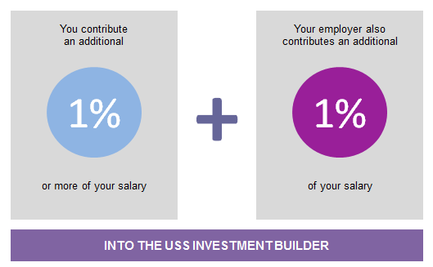
Proposal – the employer match removed
11.4%
higher than current combined contribution
10.6%
higher than current combined contribution
The employer match to be removed from
1 April 2019

Slide 24
Proposal – increase in contributions cost sharing approach… if benefits stay the same?
24.9%
for employers
= 36.6%
11.7%
for members
Phased contribution rises from
1 April 2019

Slide 25
Proposal – increase in contributions
8.8%
for members
From 1 April 2019

Slide 26
Proposal – increase in contributions
10.4%
for members
From 1 October 2019

Slide 27
Proposal – increase in contributions
11.7%
for members
From 1 April 2020

Slide 28
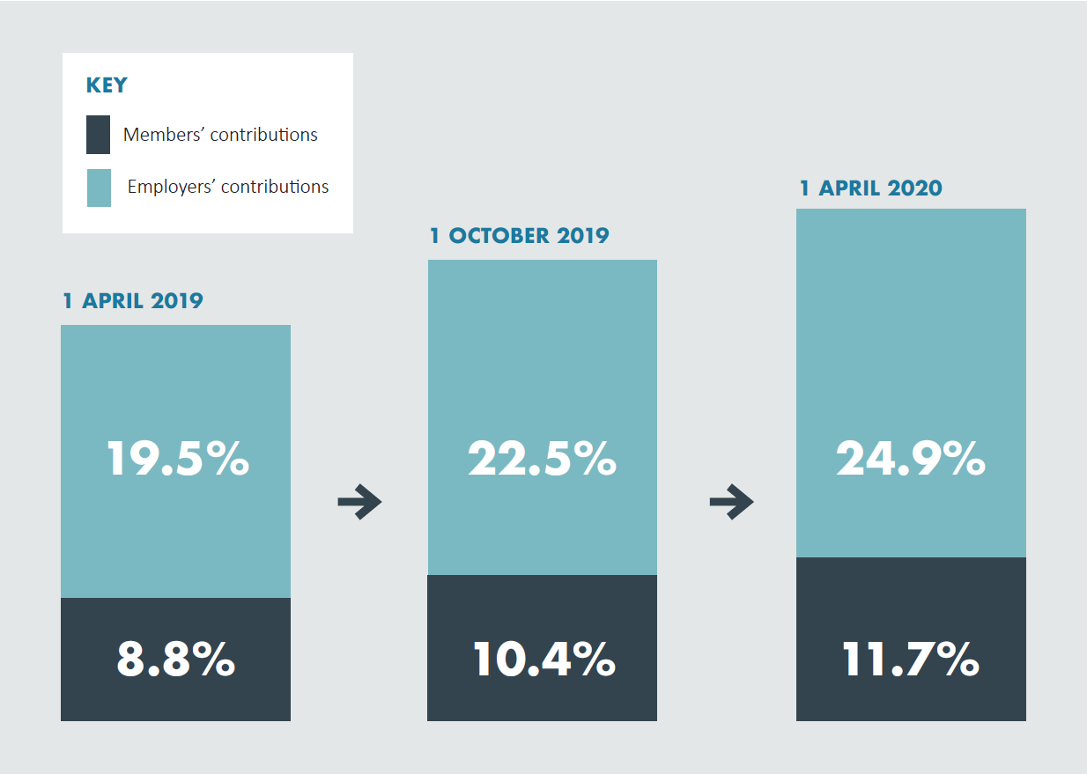
Proposal – increased contributions

Slide 29
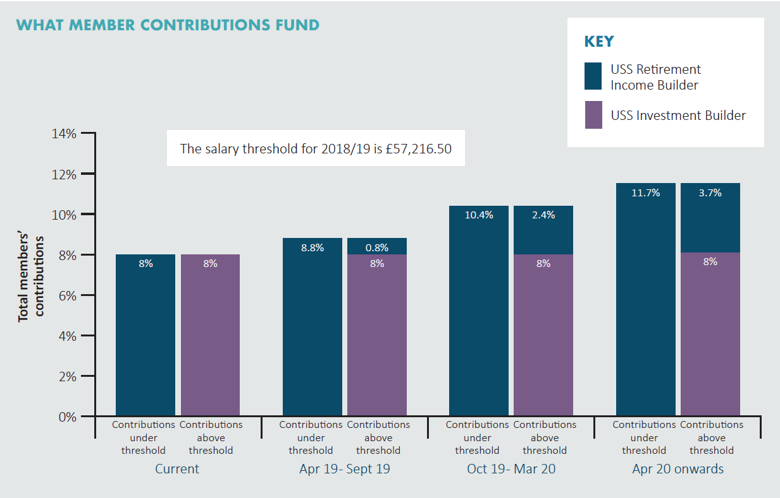
Proposal – what member contributions fund

Slide 30
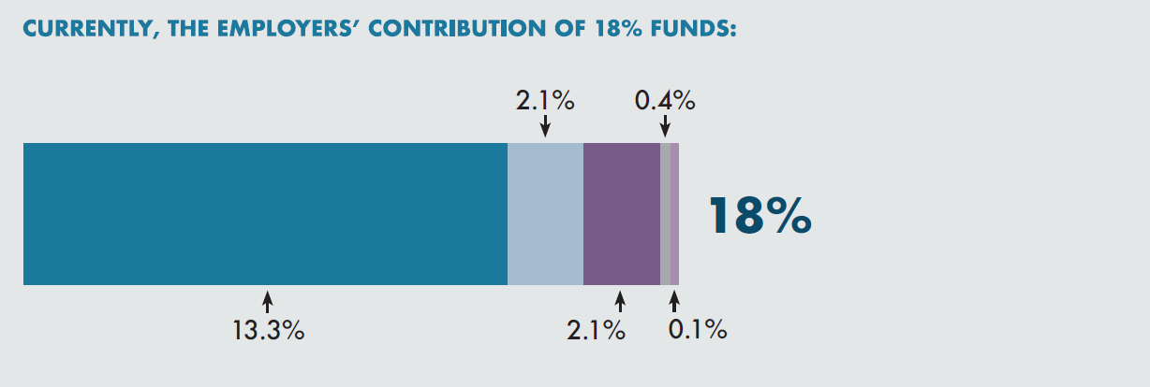
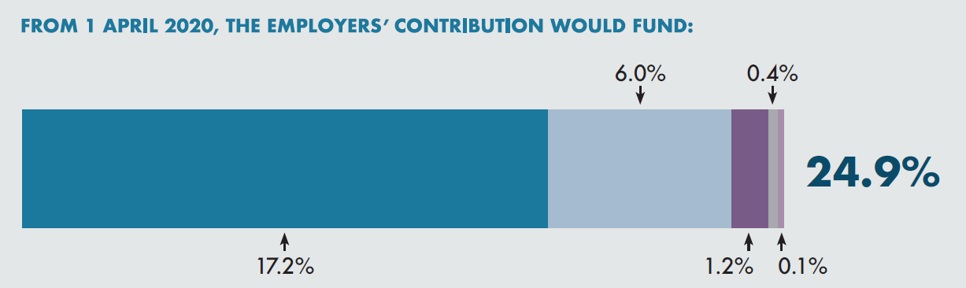
Proposal – what employer contributions fund
Benefits in the USS Retirement Income Builder
Deficit recovery
Contributions to the USS Investment Builder
Running costs
Investment manager subsidies

Slide 31
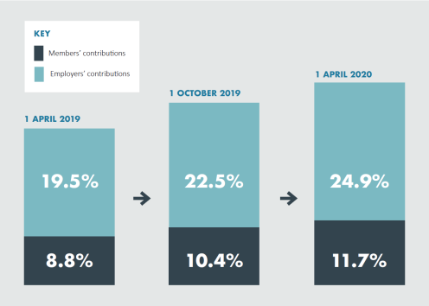
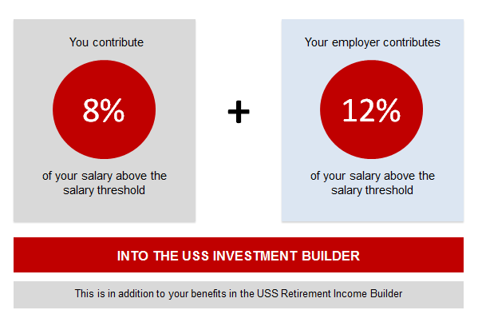
CONSULTATION Proposal - SUMMARY
The employer match will be removed from
1 April 2019
Phased contribution rises from 1 April 2019
No change to the amounts going into the USS Investment Builder above the salary threshold

Slide 32
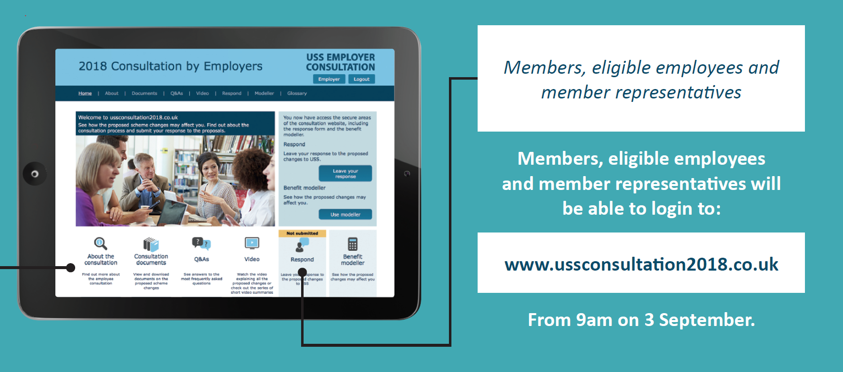
RESPONDING TO THE CONSULTATION
Until 5pm on 2 November

Slide 33
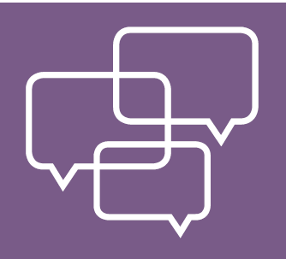

RESPONDING TO THE CONSULTATION
Share your thoughts on:
The match
Cost-sharing
Phased contribution increases
Contributions to USS Investment Builder above salary threshold
Alternative / additional proposals to address challenges from 2017 valuation

Slide 34
Section 4
WHAT happens next?

Slide 35
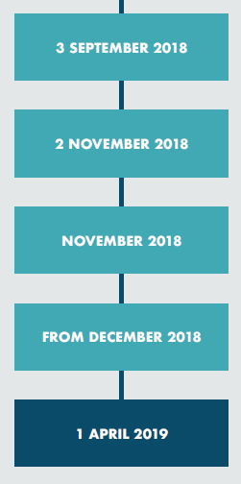
Key dates for this consultation
Consultation start date
Consultation end date (responses must be received by 5:00pm)
Responses considered and the final changes decided on
Final position communicated
Intended date for first phased contribution increase

Slide 36




Timeline
STATUTORY REQUIREMENT TO FINALISE THE VALUATION
2017
Sep/Oct 2018
1 April 2019, 1October 2019
and 1 April 2020
31 March 2017
valuation date
Member consultation on contributions
Phased implementation of increased contributions
2017
2018
2019
2020
LONGER TERM SOLUTION TO RUN IN PARALLEL
Sep 2018
2018/19
2019
JEP report
JNC decision
New consultation?

